Slide 1
A New Little Brewery in Toronto Canada

Slide 2
Introduction
A hobbyist brewer wants to open his own brewery in Toronto
He isn’t sure where in Toronto would be best
It needs to be:
In a location with few other breweries
An area he can establish himself and get repeat customers
An area he can get potential foot traffic

Slide 3
The Data Sources
Postal Codes and Neighborhoods of Toronto Canada
Found via Wikipedia
Latitude and Longitude Data for Neighborhoods
http://cocl.us/Geospatial_data
Venue Information
Found via Foursquare API

Slide 4
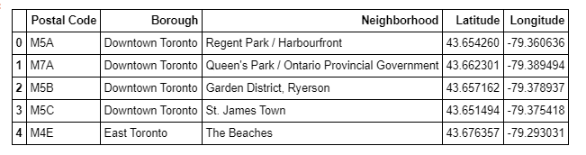
Locational data dable
The Data was scrapped from Wikipedia using Beautiful Soup
Latitude, Longitude and Neighborhood data frames were created and joined using Python Pandas

Slide 5
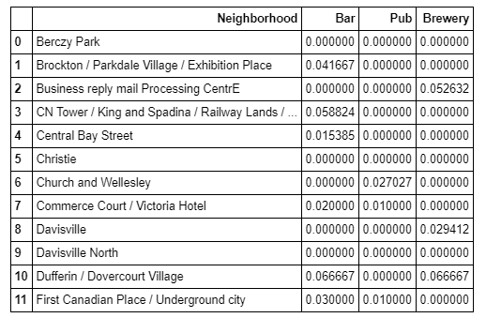
Bar, brewery and pub data
Foursquare API was used to pull Venue Categories for the Toronto Canada area
Venues with the categories of Bar, Brewery or Pub were pulled and stored inside of a dataframe

Slide 6
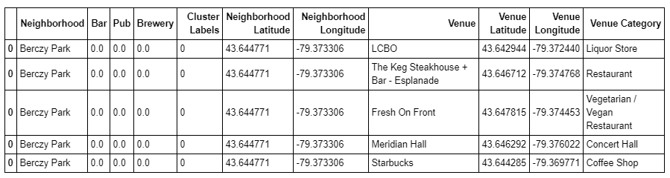
K-means clustering
K-means clustering was used on the data
5 clusters were created and labels added

Slide 7
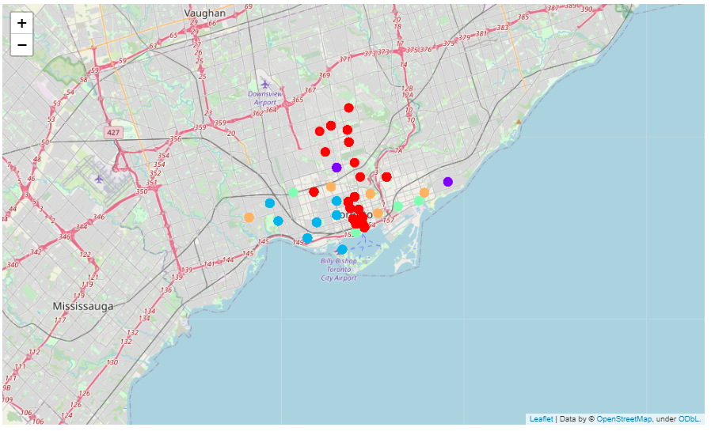
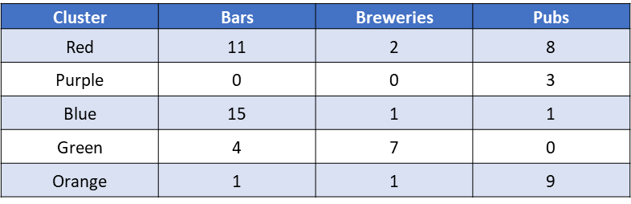
Map of K-means clustering

Slide 8
Discussion
Location needs to have little competition
Green neighborhoods eliminated
Location needs foot traffic
Purple neighborhoods eliminated
Location needs to become established
Needs loyal customer base
Ability to partner with other businesses

Slide 9
Discussion
Pub vs Bar
Bars are defined as retailers, and may be more strict on their menus
Pubs are locations where locals congregate
Locals tend to be repeat customers of Pubs
Blue cluster eliminated as it is mostly Bars

Slide 10
Discussion
Red Cluster vs Orange Cluster
Both are good spots for new Brewery
Red offers higher foot traffic and new customer potential
Orange caters more to locals, and has higher chance of obtaining repeat customres
Neighborhoods in Orange Clusters that are close to Red Clusters may benefit from runoff foot traffic without sacrificing other benefits.

Slide 11
Conclusion
It is recommended to choose a neighborhood from the orange cluster
Neighborhood that is close to The Beaches West, or Harbourfront might benefit most from proximity to high traffic areas

